Slide 1
Exception Handling

Slide 2
Exceptions and Errors
When a problem encounters and unexpected termination or fault, it is called an exception
When we try and divide by 0 we terminate abnormally.
Exception handling gives us another opportunity to recover from the abnormality.
Sometimes we might encounter situations from which we cannot recover like Outofmemory. These are considered as errors.

Slide 3
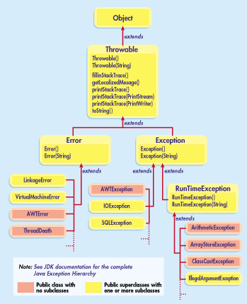
Hierarchy
Notes:
Use -Xmx to specify the maximum heap size
Use -Xms to specify the initial Java heap size
Use -Xss to set the Java thread stack size

Slide 4
Hierarchy
Throwable class is a super class of all exception and errors.
Exceptions has a special subclass, the RuntimeException
A user defined exception should be a subclass of the exception class

Slide 5
Checked and Unchecked Exception
Exceptions which are checked for during compile time are called checked exceptions.
Example: SQLException or any userdefined exception extending the Exception class
Exceptions which are not checked for during compile time are called unchecked exception.
Example: NullPointerException or any class extending the RuntimeException class.
All the checked exceptions must be handled in the program.
The exceptions raised, if not handled will be handled by the Java Virtual Machine. The Virtual machine will print the stack trace of the exception indicating the stack of exception and the line where it was caused.

Slide 6
Example
public class myexception{
public static void main(String args[]){
try{
File f = new File(“myfile”);
FileInputStream fis = new FileInputStream(f);
}catch(FileNotFoundException ex){
File f = new File(“Available File”);
FileInputStream fis = new FileInputStream(f);
}
finally{
// the finally block
}
//continue processing here.
}
}
In this example we are trying to open a file and if the file does not exists we can do further processing in the catch block.
The try and catch blocks are used to identify possible exception conditions. We try to execute any statement that might throw an exception and the catch block is used for any exceptions caused.
If the try block does not throw any exceptions, then the catch block is not executed.
The finally block is always executed irrespective of whether the exception is thrown or not.

Slide 7
Using throws clause
If you don’t want the exception to be handled in the same function you can use the throws class to handle the exception in the calling function.
public class myexception{
public static void main(String args[]){
try{
checkEx();
} catch(FileNotFoundException ex){
}
}
public void checkEx() throws FileNotFoundException{
File f = new File(“myfile”);
FileInputStream fis = new FileInputStream(f);
//continue processing here.
}
}
In this example, the main method calls the checkex() method and the checkex method tries to open a file, If the file in not available, then an exception is raised and passed to the main method, where it is handled.

Slide 8
Catching Multiple exceptions
public class myexception{
public static void main(String args[]){
try{
File f = new File(“myfile”);
FileInputStream fis = new FileInputStream(f);
}
catch(FileNotFoundException ex){
File f = new File(“Available File”);
FileInputStream fis = new FileInputStream(f);
}catch(IOException ex){
//do something here
}
finally{
// the finally block
}
//continue processing here.
}
}
We can have multiple catch blocks for a single try statement. The exception handler looks for a compatible match and then for an exact match. In other words, in the example, if the exception raised was myIOCustomException, a subclass of FileNotFoundException, then the catch block of FileNotFoundExeception is matched and executed.
If a compatible match is found before an exact match, then the compatible match is preferred.
We need to pay special attention on ordering of exceptions in the catch blocks, as it can lead to mismatching of exception and unreachable code.
We need to arrange the exceptions from specific to general.

Slide 9
Further Reading
http://docs.oracle.com/javase/tutorial/essential/exceptions/
http://www.tutorialspoint.com/java/java_exceptions.htm

